Slide 1
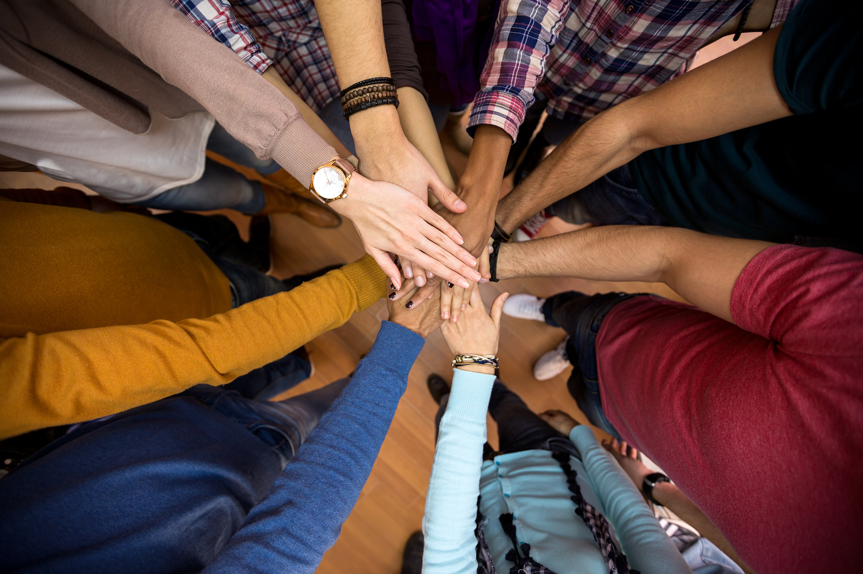
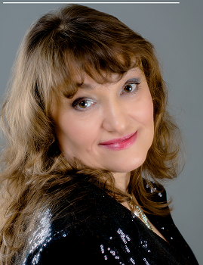
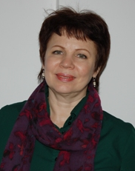
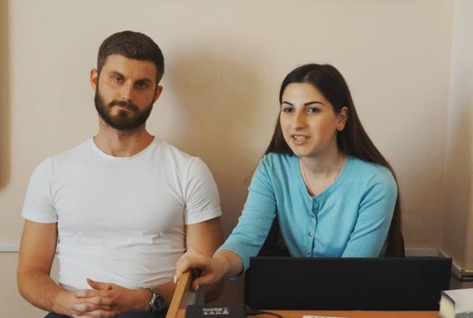
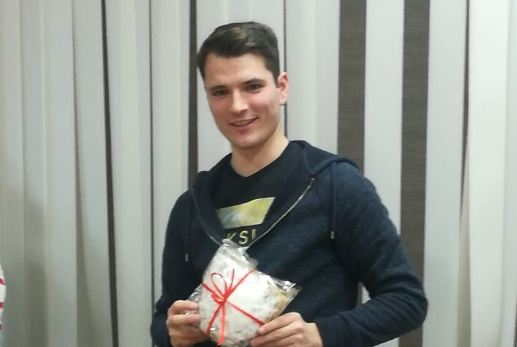
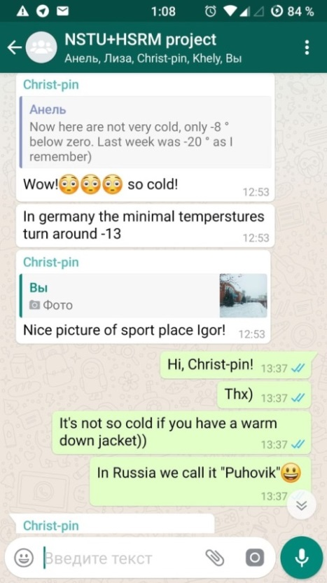
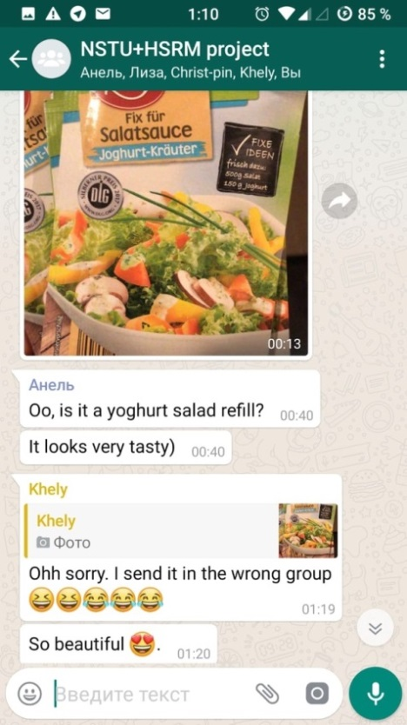
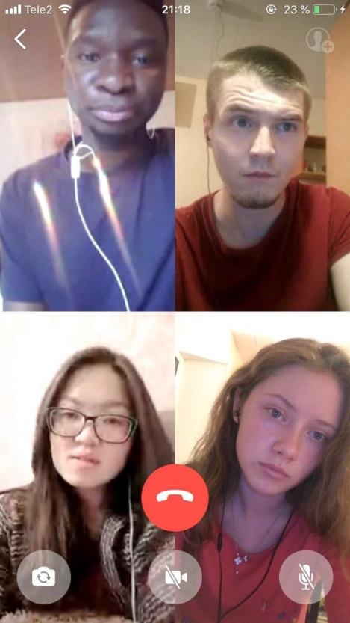
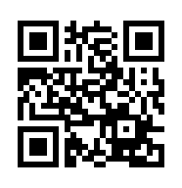
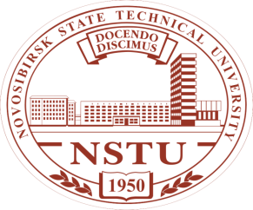
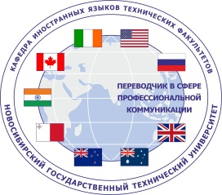
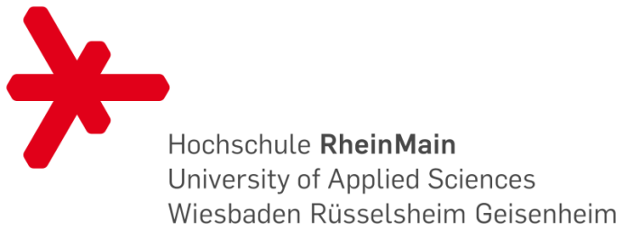
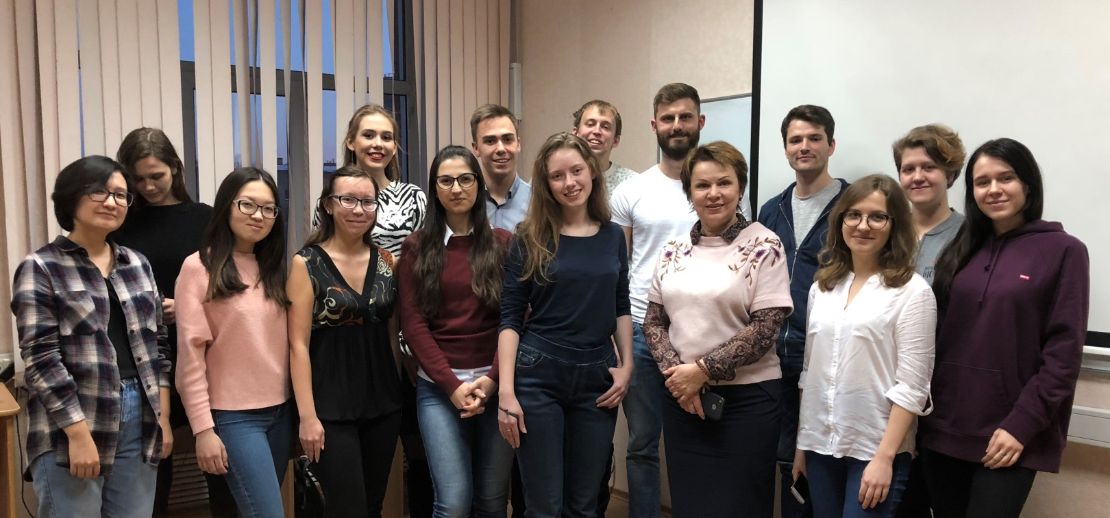
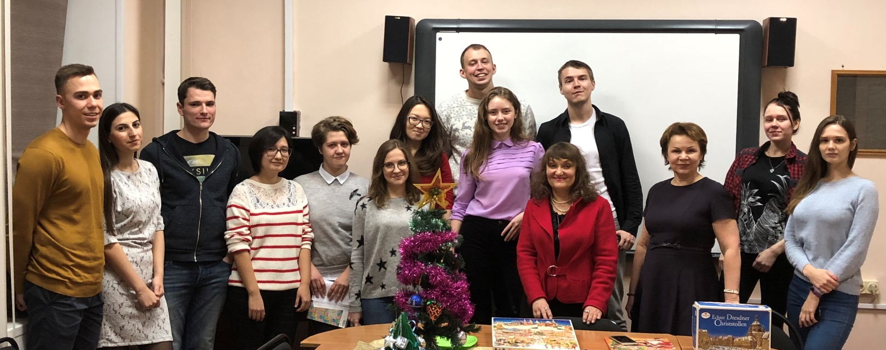
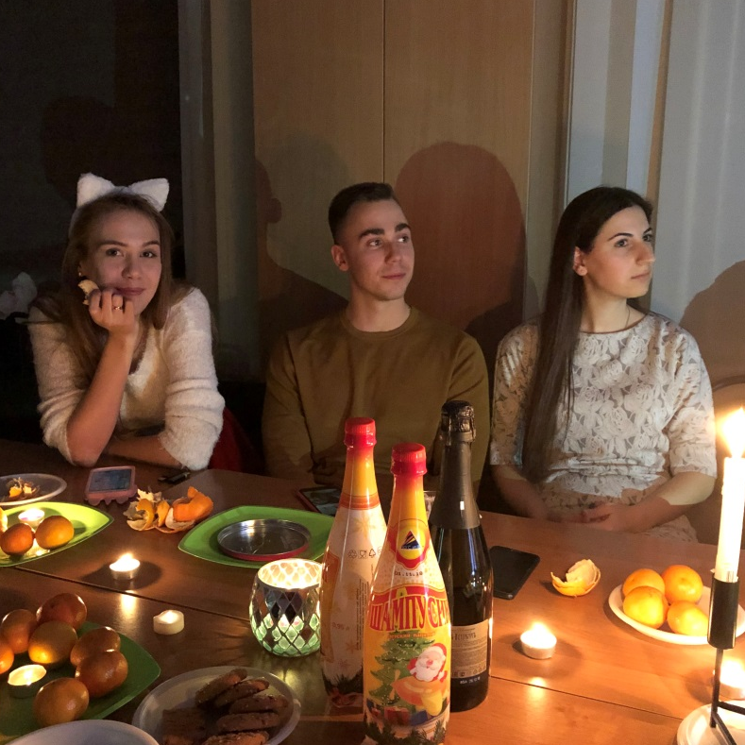
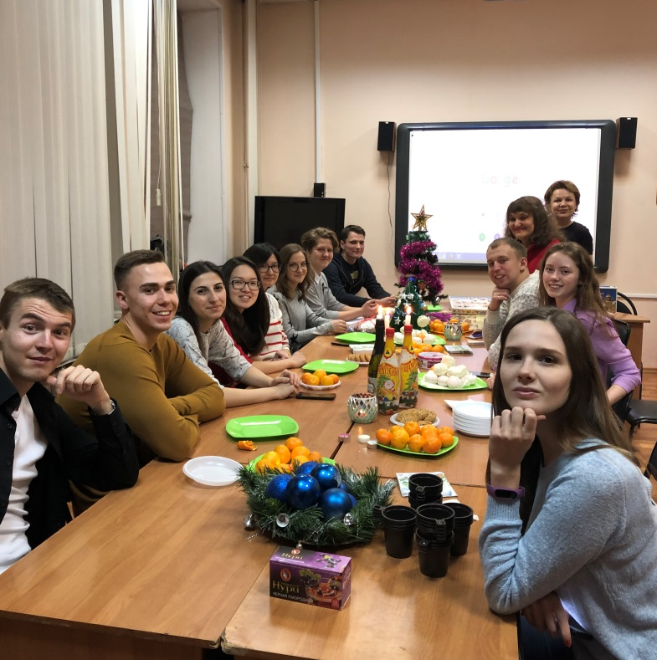
2nd ANNUAL
TELECOLLABORATIVE
PROJECT
A great networking event connecting NSTU, Russia & HSRM, Germany.
Since 2017 the program has been providing culture understanding trainings and team-building events. The participants of the project are NSTU Translation program trainees and students of HSRM (Hoch Schule Reihn Mein), Germany.
OUR AIMS
OUR EXCELLENT AND INSPIRATIONAL TUTORS
Discuss cultural theories
Analyze and compare cultures and different ways of life at university
Collaborate with students from HSRM University to research information and complete activities
Larisa F. Luchikhina and Natalia V. Elfimova are highly educated and supportive professors who are always ready to help and give wise advice about anything. They literally convey their enthusiasm and passion for their work.
Pascal and Lukas – trainees from Germany, who were also a part of our NSTU team
HOW WE GOT IN TOUCH
WHAT WE DISCUSSED
Our personal interests & ambitions
University Life
Cultural differences / taboos / dos and don’ts
Our final presentations
kaf_iy_tf@corp.nstu.ru
perevod-tf.nstu.ru
+7 (383) 346-03-23, +7 (383) 346-12-85
THE RESULTS
We used different messengers and apps for videoconferencing
“I absolutely loved it! Now I can understand other cultures more – it’s really awesome!”
Evgeny Lakomov, Russia
“I am very happy that I’m enrolled in this course and I will certanly search for additional information about Russia, on a daily basis!”
At the final videoconference in joint groups of NSTU and HSRM students we prepared our final presentations and showed them to everybody.
Chris Torres, Germany
“Everything was wonderful! Cultural insights were an eye opener.”
WHAT’S NEXT?
Elizaveta Bykova, Russia
“This project has ignited a fire in the hearts and eyes of the students!”
Oleg Marilov, Russia
“I am glad that the German students were also very passionate about the project, and we were in touch with the guys every day. We are still communicating, because we have really got to know each other..”
We spent wonderful time celebrating Christmas and New Year in
Russian & Germany traditions.
Elizabeth Tkachenko, Russia
“Participation in the telecollaborative project was the most memorable event of the last year of study. It is a great opportunity to overcome language barrier, to learn more about other cultures and to understand our own culture.”
Vera Elanakova, Russia

